Slide 1


W03 Gathering
Time Management and Goals
Welcome!!

Slide 2
Agenda
- Welcome and Devotional
- Openning Prayer: Roxana
  - Spiritual thought: Leilani
- Introduction to Spreadsheets
- Goals
  - Read and Discuss
  - Share
  - Class Activity
  - Group Presentation
Testimony and Prayer
- Closing prayer: Iyari Lozano
- Lead Students:
- Gustavo Tadeo
- Julio Celón

Slide 3
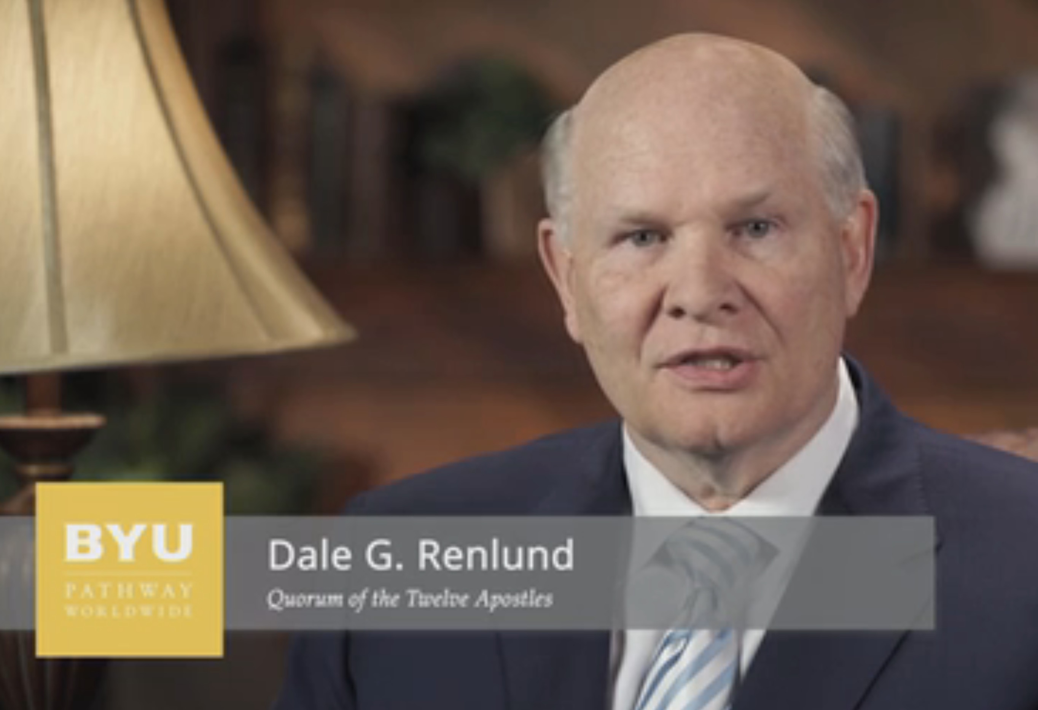
W03 Devotional
Simplification and
Inspiration
April 02, 2019

Slide 4
W03 Devotional
Discussion Questions for the Gathering
As you think of your list of things to do, what can you simplify or remove?
What is absolutely critical to keep in your life?

Slide 5
W03 Devotional
From Liberty Jail, Joseph Smith authored these optimistic words, “Therefore … let us cheerfully do all things that lie in our power; and then may we stand still, with the utmost assurance, to see the salvation of God, and for his arm to be revealed.”¹ When he said, “do all things that lie in our power,”
Joseph implied that you should focus on things that are important and expend a reasonable effort accomplishing those things.
He neither implied that you do every possible thing, nor that you run faster than you are able; your effort needs to be sustainable. To know what things are most important, though, you need the help of the Holy Ghost. Once you know your path is inspired, commit to make the reasonable, Spirit-directed effort. As you do, you can count on God’s help.
To simplify and balance the demands of your life requires that you keep your eye on the most important responsibilities that you are juggling.

Slide 6
W03 Application Activity:
Introduction to Spreadsheets

Slide 7
Goals
One way to be a good steward of your time is to set and achieve goals. Preach My Gospel states that “Goals reflect the desires of our hearts and our vision of what we can accomplish. Through goals and plans, our hopes are transformed into action”
Top-Level Goals
Top level goals are the things you care about the most. These goals give meaning and purpose to your life.
Figuring out your top-level goal can be difficult. To help with this, think about your highest professional goal. What do you want to do for work? What do you enjoy so much that you would be willing to invest thousands of hours practicing? The answers to these questions are your top level goals.
What are some examples of “top-level” goals?

Slide 8
Top-Level Goals
What are some examples of “top-level” goals?
Figuring out your top-level goal can be difficult. To help with this, think about your highest professional goal. What do you want to do for work? What do you enjoy so much that you would be willing to invest thousands of hours practicing? The answers to these questions are your top level goals.
Becoming a school teacher
Being a great parent
Eternal marriage and family

Slide 9
Mid and Lower-Level Goals
Mid-level goals support your top-level goals by breaking them down into major themes.
Top level goals are more general, but smaller goals are more specific. Lower-level goals are even more specific and tend to be linked to certain everyday tasks. It is through these tasks that the larger mid and top-level goals can be met.
What are some lower-level goals you could set in order to achieve some of these “top-level” goals?
Have a healthy diet
Obtain a good job
Spend time with family

Slide 10
What are the principles of Effective Goals?
S
M
A
R
T

Slide 11
What are the principles of Effective Goals?
Specific
Measurable
Actionable
Relevant
Time Bound

Slide 12
Principles of Effective Goals
Example
Specific: Have Family Home Evening one night during the week at 6:00 p.m.
Measurable: It can be observed, recorded, and scheduled on a calendar.
Actionable: Everyone in the family can adjust their schedule to this time.
Relevant: It directly relates to the goal to spend time as a family and be a good parent.
Time Bound: Occurs every (specific night of the week), for 60 minutes.

Slide 13
Example of a goal in my own life
Eternal marriage and family
Secular preparation
Spiritual preparation
To be a good provider for my family
Serve as a missionary
Graduate Seminary and Institute
Save money
Obtain a good job
Make y keep sacred covenants
Graduate from University
Attend and participate to classes
Attend to classes and
have good grades
Attend to church meetings
Graduate from High School
Repentance and keep commandments everyday

Slide 14
Class Activity
- Divide the class into two groups
- Each group will work on one of the scenarios
- Their task will be to identify a solid top-level goal as well as two lower-level goals for the person in the scenario.
- They will also need to apply the principles of effective goals for one of the lower-level goals.
- 10 minutes to complete their assignment, then come back together.

Slide 15
Class Activity
Group 1
Crispín del Angel
Jessica Guevara
Demian Ramirez
Emily Uribe
Gabriel Herrera
kev
Leilani Diaz
Rodolfo Velasco
Sailyn Valdivia
Bere Rss
Julio Celón
Group 2
Alejandro Perez
Gerardo Martínez
Leilani Flores
Demian Ramirez
Iyari Lozano
Jacky Anzo
Nokile Flores
Rox Basurto
Ulises Jesus
Idel Hernandez
Gustavo Tadeo

Slide 16
Stan Scenario #1
Stan has wanted to cut back on his electronic usage (video games and social media usage) for years, but he hasn’t been able to successfully do so yet. This is because he doesn’t have a motivating top-level goal. A top-level goal needs to be motivating and remind Stan of what achieving this goal might feel and look like for him and those closest to him. It needs to be simple enough for him to remember and yet specific enough that it reminds him of why he wants to cut back on his electronic usage.
What would be a good top-level goal for Stan?_save money for a bigger specific porpuse // spending more time with God _________
Setting a top-level goal is not enough. It establishes the “why” and desired end-result of the goal, but it does not answer the “how.” How will Stan cut back on his electronic usage? What concrete steps can he take now to start cutting back?
List two good lower-level goals for Stan__________
Find a job
Have a budget
Change his activities for going to institute each week
Select one of those lower-level goals and apply the principles of effective goals below:
Specific. What will be the specific result of your goal? __________
Measurable. How will you measure your progress?__________
Actionable. Will you be able to achieve this goal? __________
Relevant. How does this goal support a mid-level or top-level goal? __________
Time Bound. What is the specific date when you will accomplish this goal? __________

Slide 17
Stan Scenario #2
Stan has wanted to cut back on his spending and get out of debt for years, but he hasn’t been able to successfully do so yet. This is because he doesn’t have a motivating top-level goal. A top-level goal needs to be motivating and remind Stan of what achieving this goal might feel and look like for him and those closest to him. It needs to be simple enough for him to remember and yet specific enough that it reminds him of why he wants to cut back on his spending and get out of debt.
What would be a good top-level goal for Stan?__________
Setting a top-level goal is not enough. It establishes the “why” and desired end-result of the goal, but it does not answer the “how.” How will Stan cut back on his spending and get out of debt? What concrete steps can he take now to start budgeting better and get out of debt?
List two good lower-level goals for Stan__________
Select one of those lower-level goals and apply the principles of effective goals below:
Specific. What will be the specific result of your goal? __________
Measurable. How will you measure your progress?__________
Actionable. Will you be able to achieve this goal? __________
Relevant. How does this goal support a mid-level or top-level goal? __________
Time Bound. What is the specific date when you will accomplish this goal? __________

Slide 18
Group Presentation
- Each group will presente on their scenario solutions for Stan
- Explaining why they feel these goals are the best option for him
- How do you applied the principles of effective goal setting to one of his lower-level goals.

Slide 19
Testimony and Prayer
- Closing prayer: Iyari Lozano

Slide 20
W03 Gathering
Time Management and Goals
Thank you!!

